Slide 1
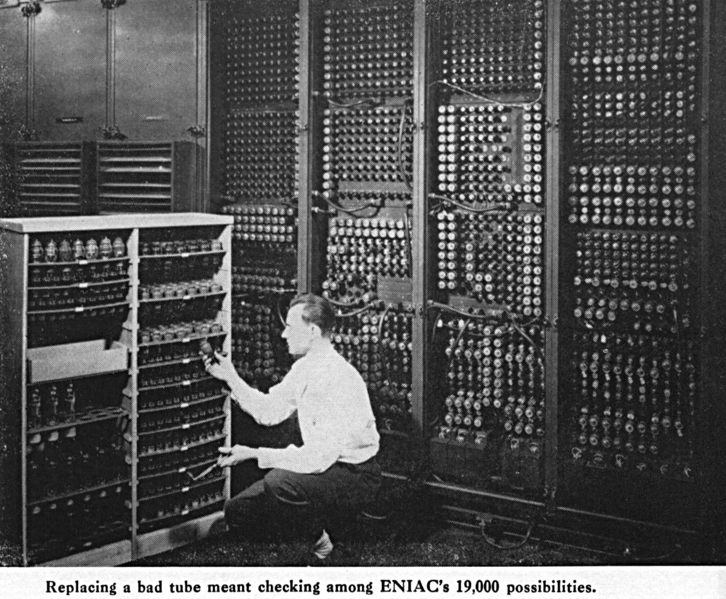
M. Weik, The ENIAC STORY

Slide 2
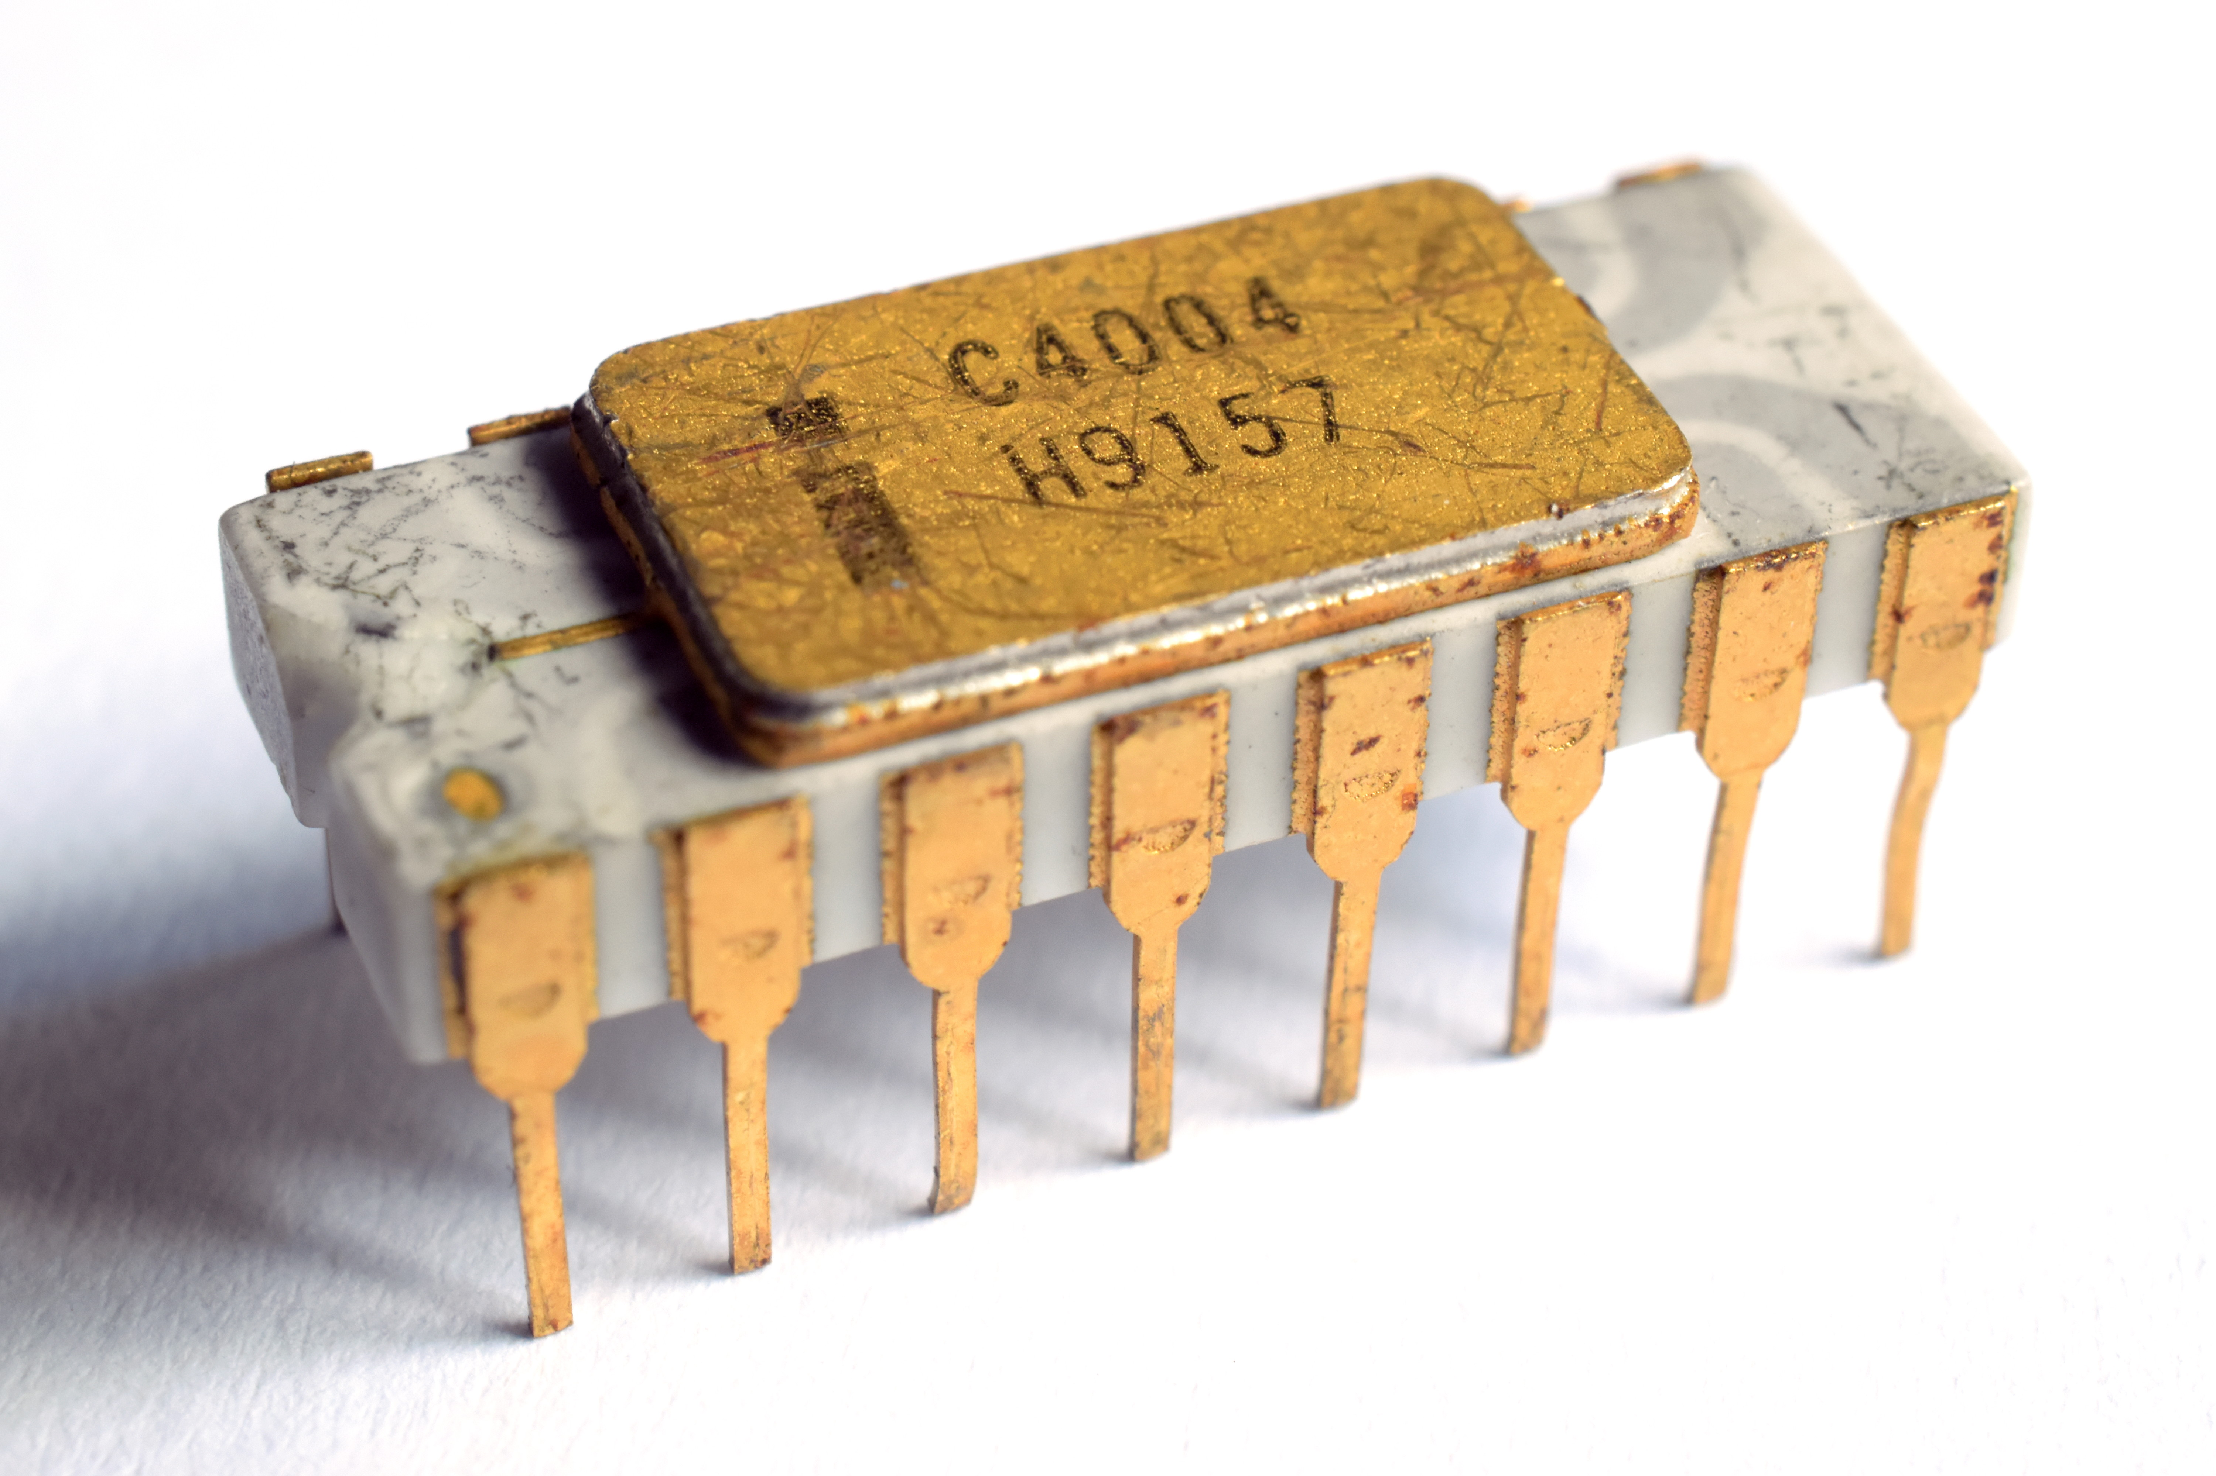
Photo of Thomas Nguyen

Slide 3
THE BENEFIT OF
MELTDOWN CPU FLAW

Slide 4
What is a processor?
Makes calculations,
Stores in registers,
Writes in memory,
That’s it!

Slide 5
RAM
DISK
BUS
CPU

Slide 6
RAM
DISK
L1
CPU

Slide 7
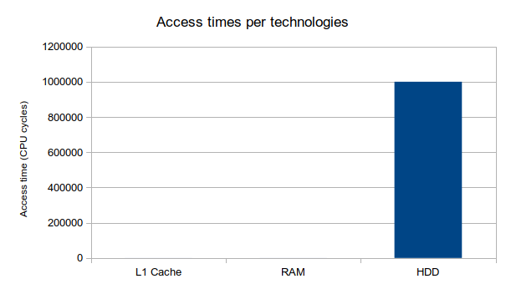

Slide 8
What does a processor do at this point?
Fetches an instruction
Decodes it
Executes it
Eventually access a memory location
Stores the result in a register

Slide 9
Introducing Pipelining
1 cycle
1 cycle
1 cycle
1 cycle
Dec
Fetch
Align
Decod
Calc
Exec
Normlz
Mem
Dec
Fetch
Align
Decod
Calc
Exec
Normlz
Mem

Slide 10
load r2, adr14
Dec
Fetch
Align
Decod
Calc
Exec
Normlz
Mem
Dec
Fetch
Align
Decod
Calc
/!\ Exec
Normlz
load r5, r2, r4
Mem

Slide 11
1 cycle
1 cycle
1 cycle
1 cycle
load r2, adr14
Dec
Fetch
Align
Decod
Calc
Exec
Normlz
Mem
Dec
Fetch
Align
Decod
Calc
load r5, r2, r4
Nop
Exec
Mem

Slide 12
Super-scalar
Dec
Fetch
Align
Decod
Calc
Exec
Normlz
Mem
Dec
Fetch
Align
Decod
Calc
Exec
Normlz
Mem
Dec
Align
Decod
Calc
Exec
Normlz
Mem
Normlz
Fetch
Mem
Dec
Fetch
Align
Decod
Calc
Exec
Normlz
Mem
Normlz
Mem

Slide 13
Benefits
Benefits
  Speeds up the effective CPU cycle time
Drawbacks
  Creates conflicts and dependancies

Slide 14
Speculative execution
If Case A
  Then Computation A
Else
  Computation A
  Computation B
Why not make computation B and then choose? :D

Slide 15
Let’s hack!

Slide 16
At the beginning there was
Kernel Adress Space Layout Randomization
(KASLR)

Slide 17
What now?
KAISER
(Kernel Address Isolation to Have Side-Channels Efficiently Removed)

Slide 18
Benefits :
  No more side-channels → No more SC Attacks
Drawbacks :
  Kernel space becomes uncached

Slide 19
Benefits :
  No more side-channels → No more SC Attacks
  5 to 30% drop in performance
Drawbacks :
  Kernel space becomes uncached

